Slide 1


Top Discriminator Efficiencies and Signal Over Bkg for several selection Categories NTUA
Giannis Papakrivopoulos
George Bakas

Slide 2
Overview
Efficiencies vs all variables
mTTbarParton
ptTTbarParton
yTTbarParton
partonPt
partonEta
Yields for all samples for all variables
Categories:
1. Both jets are top tagged and b tagged
Cuts:
Reco:
nJets > 1,
|jetEta| < 2.4 (both jets)
jetPt > 400 GeV (both jets)
120 GeV < jetMassSoftDrop < 220 GeV (both jets)
Parton:
|etaParton| < 2.4 (both partons)
ptTopParton > 400 GeV (both partons)
mTTbarParton > 1000

Slide 3
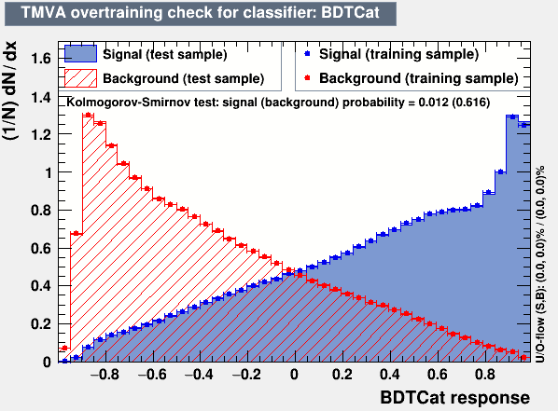
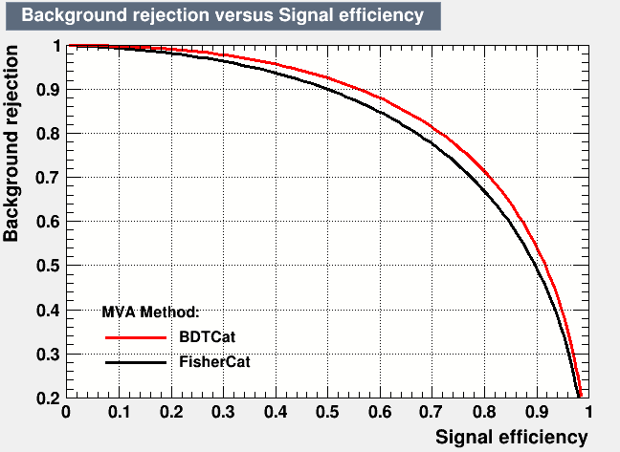
Training

Slide 4
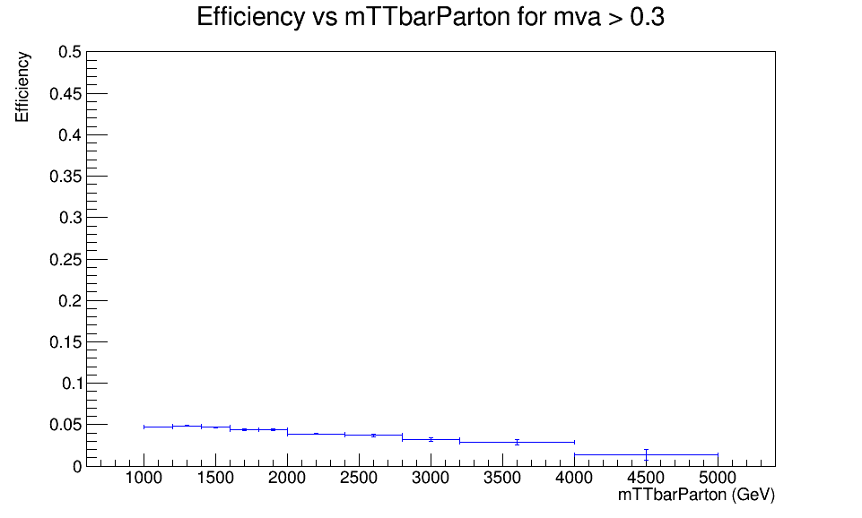
Efficiency vs mTTbarParton
Top tagger cut : 0.3
B-tagging: Medium working point
Mtt Samples

Slide 5
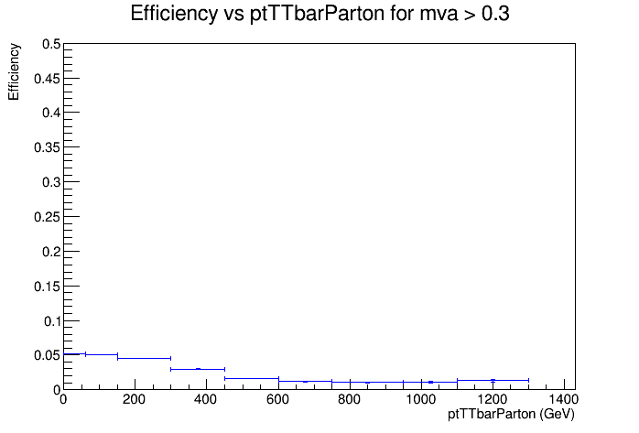
Efficiency vs ptTTbarParton
Top tagger cut : 0.3
B-tagging: Medium working point
Mtt Samples

Slide 6
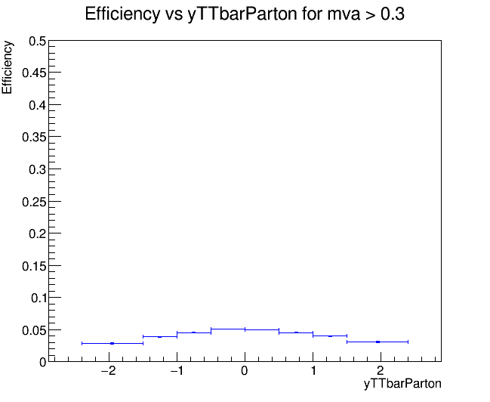
Efficiency vs yTTbarParton
Top tagger cut : 0.3
B-tagging: Medium working point
Mtt Samples

Slide 7
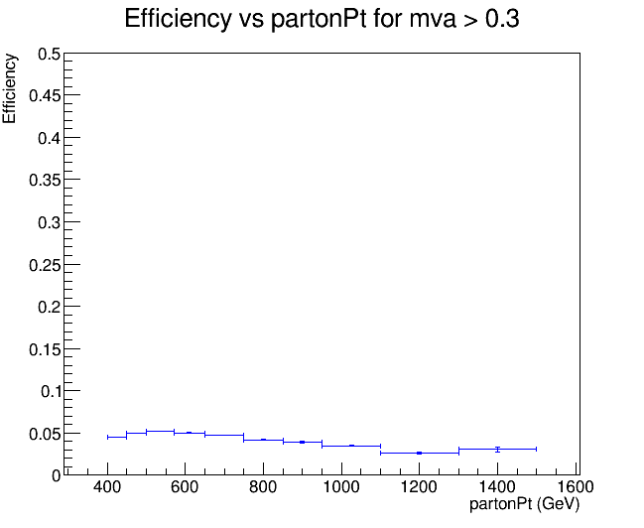
Efficiency vs partonPt
Top tagger cut : 0.3
B-tagging: Medium working point
Mtt Samples

Slide 8
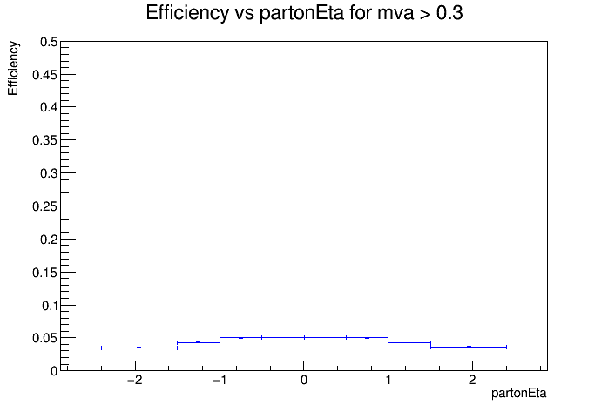
Efficiency vs jetPt
Top tagger cut : 0.3
B-tagging: Medium working point
Mtt Samples

Slide 9
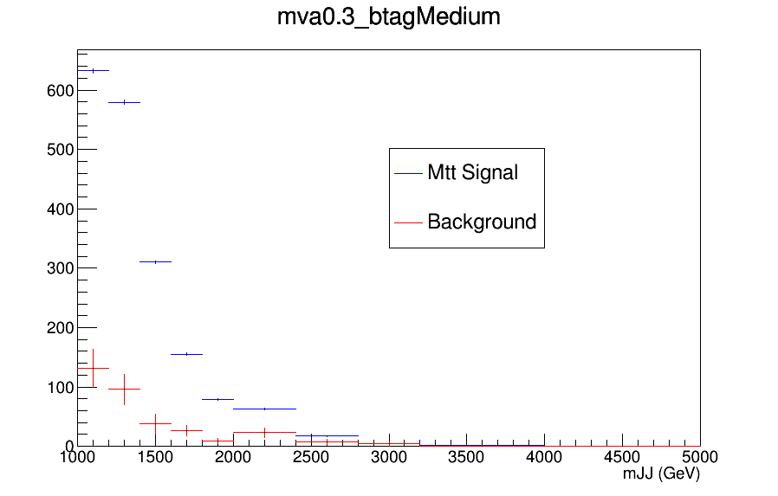
Expected Yields vs mJJ

Slide 10
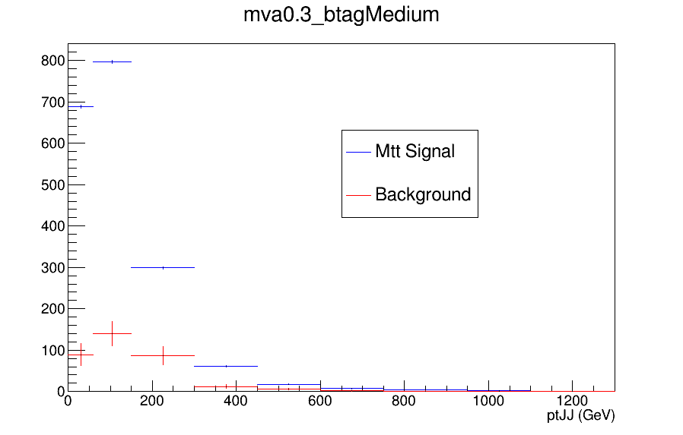
Expected Yields vs ptJJ

Slide 11
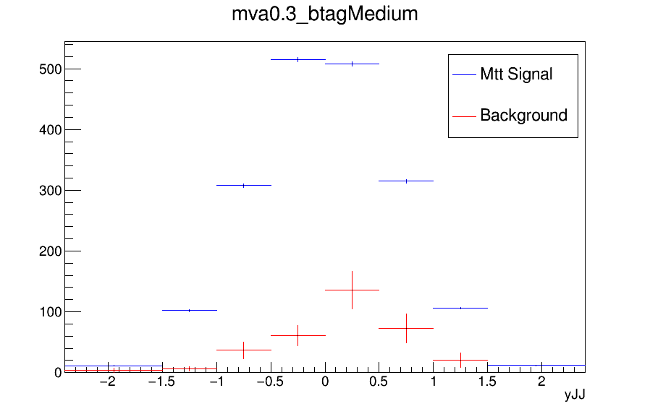
Expected Yields vs yJJ

Slide 12
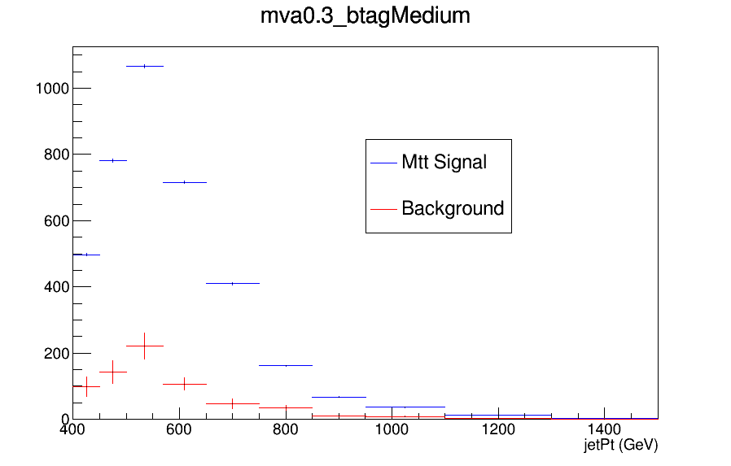
Expected Yields vs jetPt

Slide 13
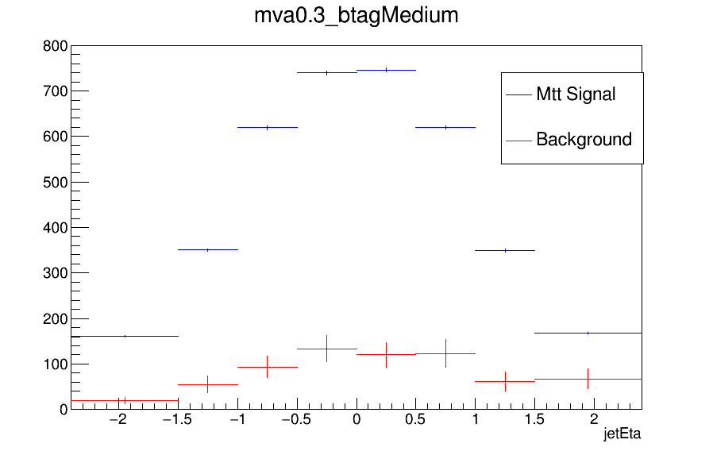
Expected Yields vs jetEta

Slide 14
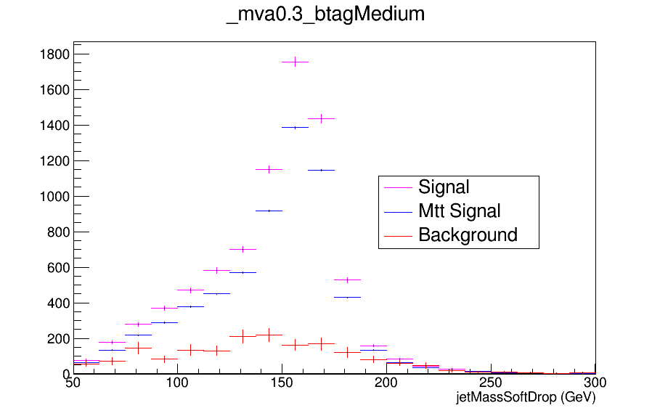
Expected Yields vs JetMassSoftDrop (double fill)

Slide 15
Comments and Questions
In the last presentation, we saw that both Mtt sample efficiencies and Nominal MC efficiencies have very similar shapes. But specifically for the efficiency in the medium WP at low mva cuts (vs mTTbarParton) we can see that in the Mtt sample it is dropping while in the Nominal MC the efficiency seems to stabilize.
nominal TT_TuneCUETP8M2T4_13TeV-powherg-pythia8
Mtt Samples
Top tagger cut : 0.3
B-tagging: Medium working point

